Slide 1
React JS
(CALLING API In REACT)
Lecture-36

Slide 2
Today’s Agenda
Introduction To Api Calling / Http Request
Revising useEffect() Hook
Using fetch()
Example

Slide 3
What Is API Calling?
Till now all the examples we have discussed have used dummy data generated by the app itself.
But while creating a real world app we need to communicate with a server for getting the REAL DATA.

Slide 4
What Is API Calling?
For example:
Suppose we want to build an app that displays weather details of the city entered by the user

Slide 5
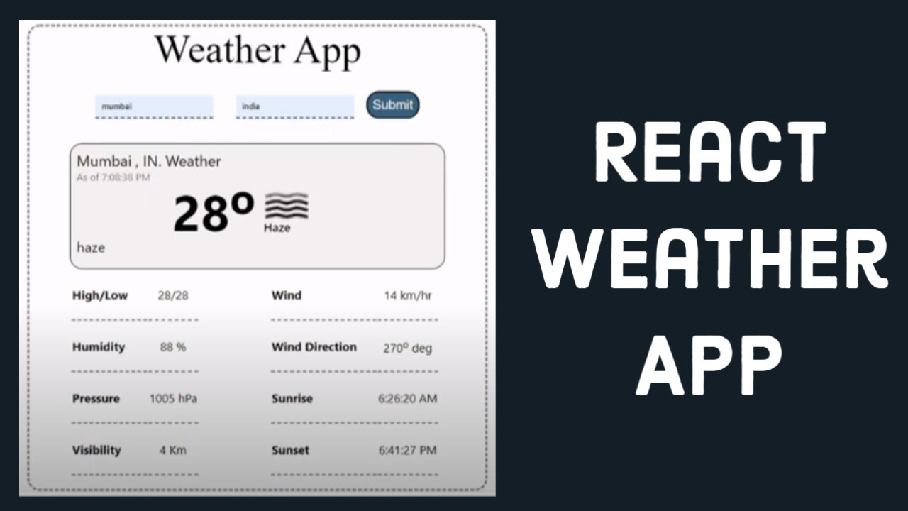
What Is API Calling?

Slide 6
What Is API Calling?
While building this type of app, we have to make our app communicate with a third party server that has all the weather information.
So we will simply pull the weather data from the server and render it on our UI.

Slide 7
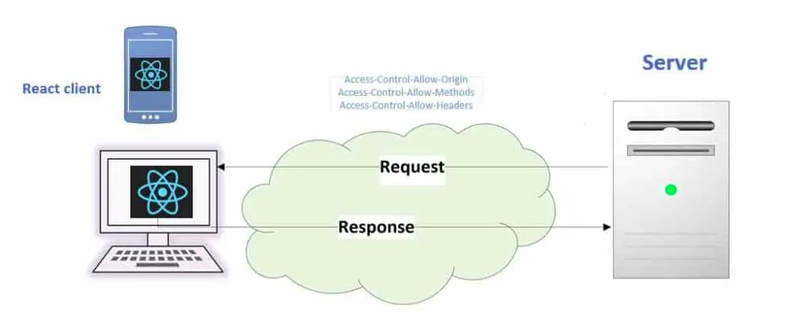
What Is API Calling?
This pulling of data from the server will be done by giving an API Call / HTTP Request to the server from our react app .

Slide 8
Different Ways Of Sending HTTP Request In React
React itself has no built in library for sending an HTTP REQUEST to the server but there are many other ways to do this:
XmlHttpRequest
Axios
The fetch API

Slide 9
Considerations Before Fetching The Data
When we request the data, we must make arrangements to store the data upon return.
We have 3 options for it :
a state management tool like Redux or
in a context object or
in the React state.

Slide 10
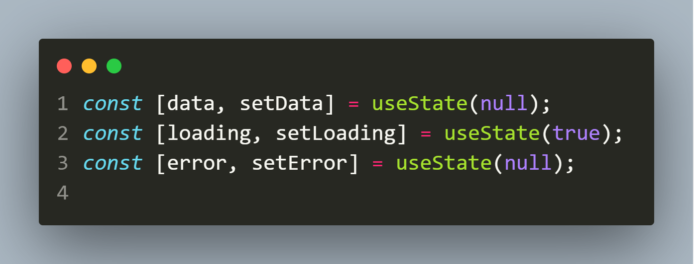
Considerations Before Fetching The Data
Next, if the data takes time to load or doesn’t load, we must provide a state to manage the loading stage to improve the user experience and another state to manage the error if anything goes wrong.
This gives us three state variables like so:

Slide 11
The useEffect() Hook
When we request to fetch the data from the backend, it is called a side effect.
This is because it is an operation that can generate different outputs for the same data fetching.
For instance, the same request might return a success or error.

Slide 12
The useEffect() Hook
In React, we should avoid performing side effects directly within the component body to avoid inconsistencies.
Instead, we can isolate them from the rendering logic using the useEffect() Hook.

Slide 13
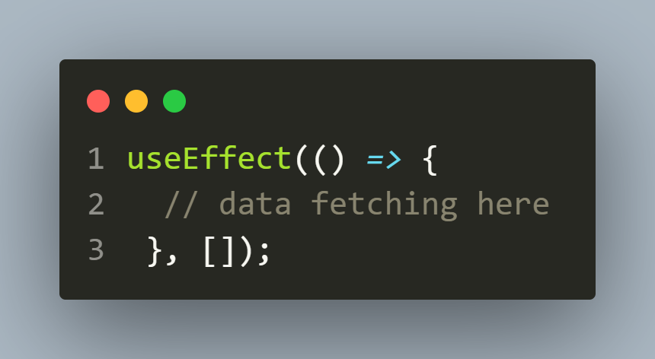
The useEffect() Hook
In this case, we will fetch our data in the Hook like so:

Slide 14
The useEffect() Hook
The previous code snippet will run and fetch the data on a component mount, that is, on the first render.
This is sufficient for most of our use cases.
In other scenarios, however, when we need to refetch the data after the first render, we can add dependencies in the array literal to trigger a rerun of useEffect().

Slide 15
The Fetch API
The Fetch API is a promise-based API of JavaScript for making asynchronous HTTP requests.
With this API , we can perform different types of operations using HTTP methods like the GET method to request data from an endpoint,or POST to send data to an endpoint, and more.

Slide 16
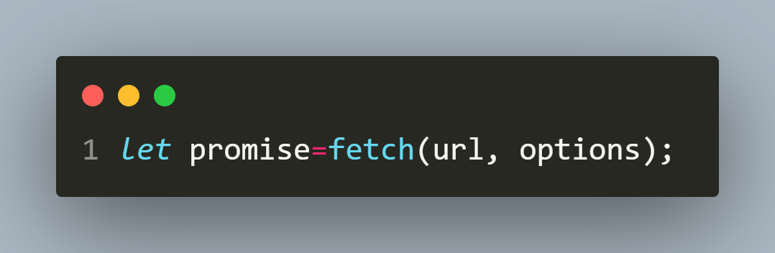
How To Use Fetch API ?
The Fetch API provides us just a single method to be called known as fetch() method.
To use Fetch API we call the fetch() method which requires only one compulsory parameter which is the URL of the resource that we want to fetch:

Slide 17
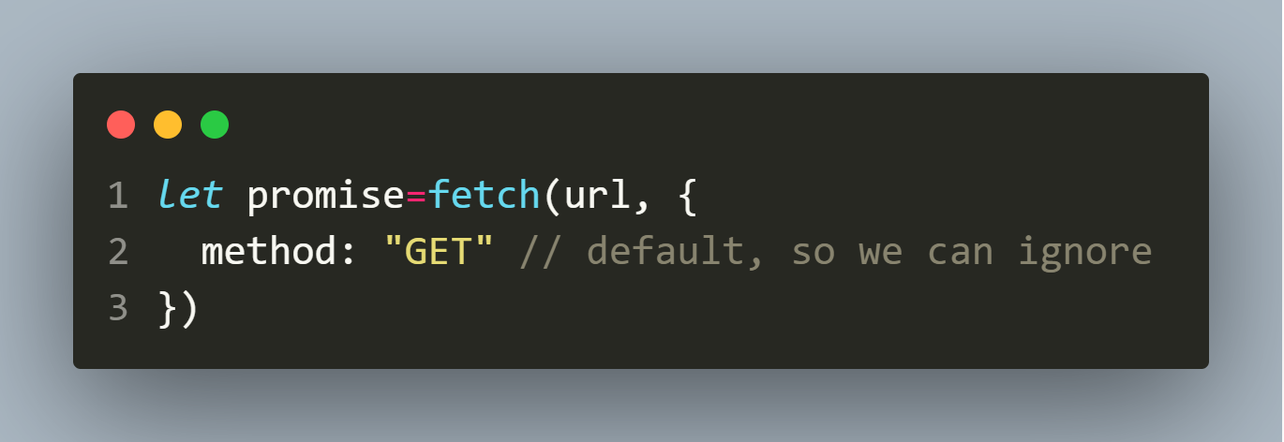
How To Use Fetch API ?
We can also specify the HTTP method in the optional parameter.
For the GET method, we have the following:

Slide 18
What Is A Promise ?
In JavaScript, a Promise is an object that returns a value which we hope to receive in future, but not now.
Because the value will be returned by the Promise object in the future, it is very well-suited for handling asynchronous operations.

Slide 19
What Is A Promise ?
It’ll be easier to understand the concept of JavaScript promises through a real world example.
Suppose that you have been assigned a project and you promise to complete it by next month.

Slide 20
What Is A Promise ?
Now you don’t know if you will be really able to complete the project until next month.
You can either be completing it or not.
Thus there are three possibilities:
Pending: you don’t know if you will complete the project by next month.
Fulfilled: you completed your project by the next month.
Rejected: you couldn’t complete the project.

Slide 21
States Of A Promise
A Promise in JavaScript just like a promise in real-world has 3 states.
It can be:
unresolved (pending),
resolved (fulfilled), or
rejected

Slide 22
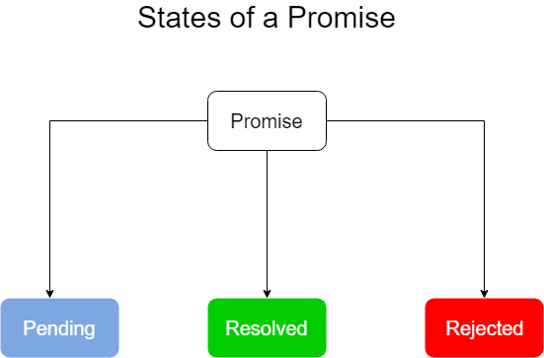
States Of A Promise

Slide 23
Working With Promise
In order to work with Promise , we need to take 2 steps:
1. Creating A Promise ( this will be done by fetch() )
2. Consuming A Promise ( this will be done by us )

Slide 24
Consuming A Promise
Now since the task of creating a Promise will be done by fetch() method so , let’s understand how to consume it
We consume a promise by calling it’s two methods :
then() and catch().

Slide 25
The then() Method
The then() method is used to schedule a callback to be executed when the promise is successfully resolved.
It takes two callback functions:
Syntax:
promiseObject.then(onFulfilled, onRejected);
The onFulfilled callback is called if the promise is fulfilled.
The onRejected callback is called when the promise is rejected.

Slide 26
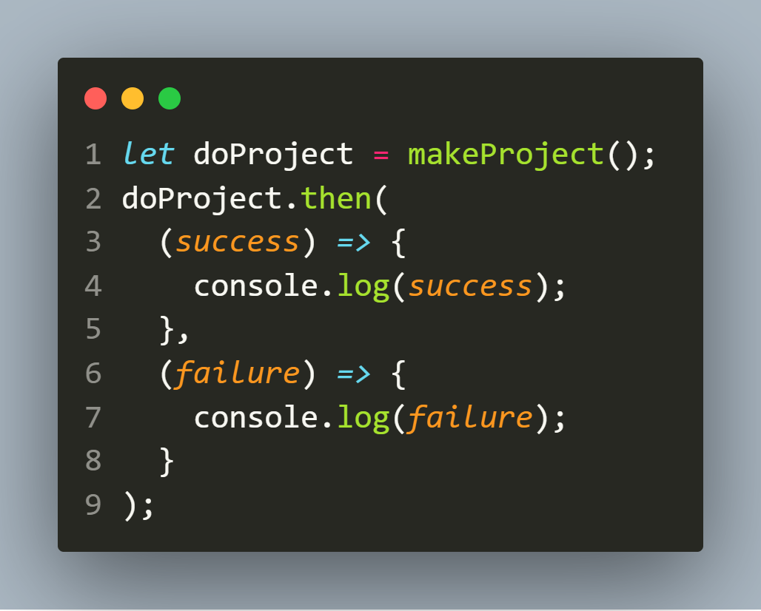
The then() Method

Slide 27
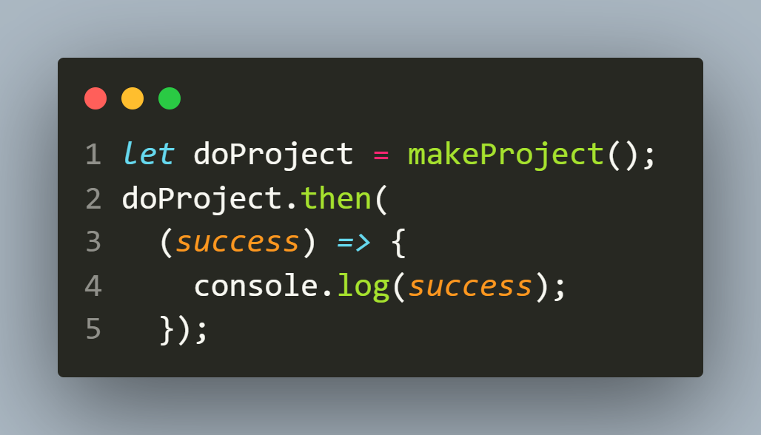
Handling Only One State
It is possible to schedule a callback to handle the fulfilled or rejected case only.
The following runs the fulfilled case:

Slide 28
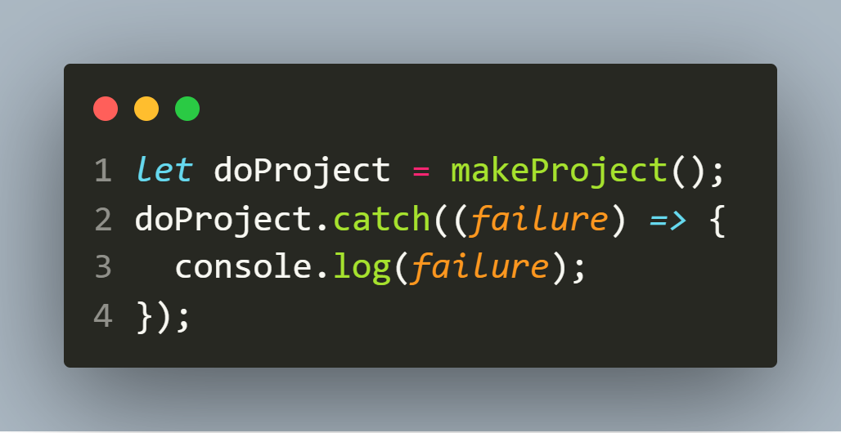
The catch()Method
If we want to schedule a callback to be executed when the promise is rejected, we can use the catch() method of the Promise object:

Slide 29
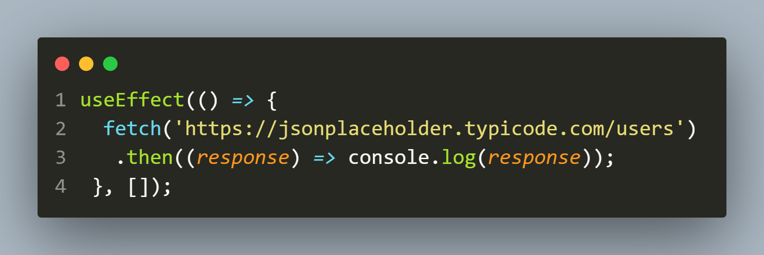
Using fetch()
By applying what we’ve learned so far, a typical fetch() request looks like the following:

Slide 30
Using fetch()
In the previous code, we are using the fetch() method to request users data from the resource endpoint as seen in the useEffect() Hook.
This operation returns a promise that could either resolve or reject.

Slide 31
Using fetch()
If it resolves, we handle the response using .then().
But at this stage, the returned data is a Response object, which is not the actual format that we need.

Slide 32
Using fetch()
In order to get the JSON body content from the Response, we’d have to change the Response to actual JSON using the json() method on the Response.
This also returns a promise and from there, we can resolve to get the actual data that we need.

Slide 33
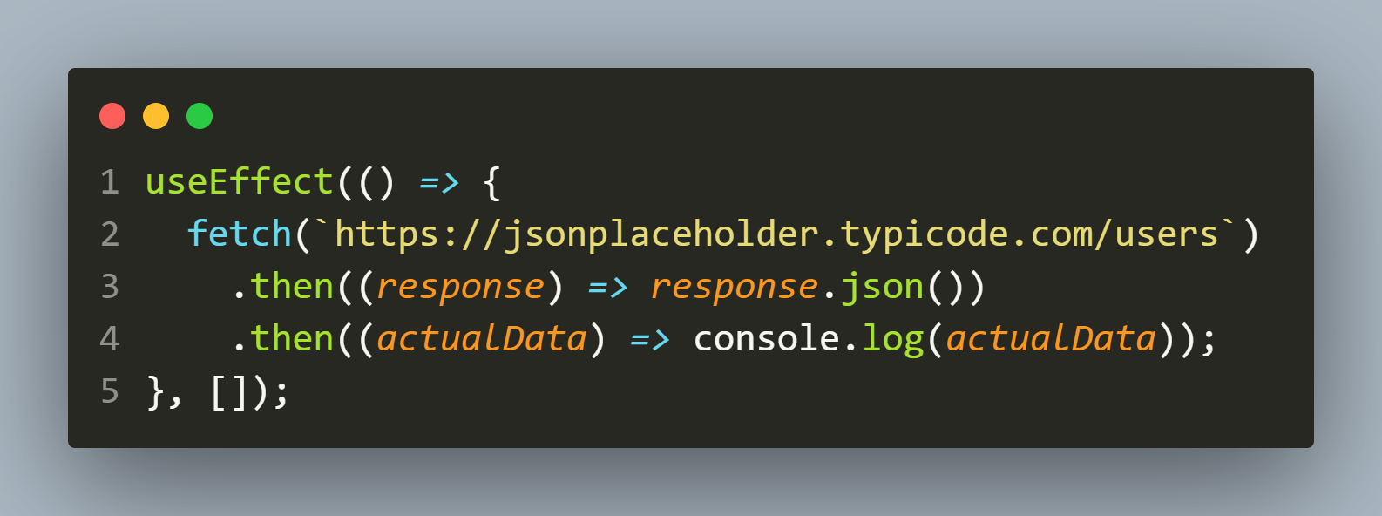
Using fetch()

Slide 34
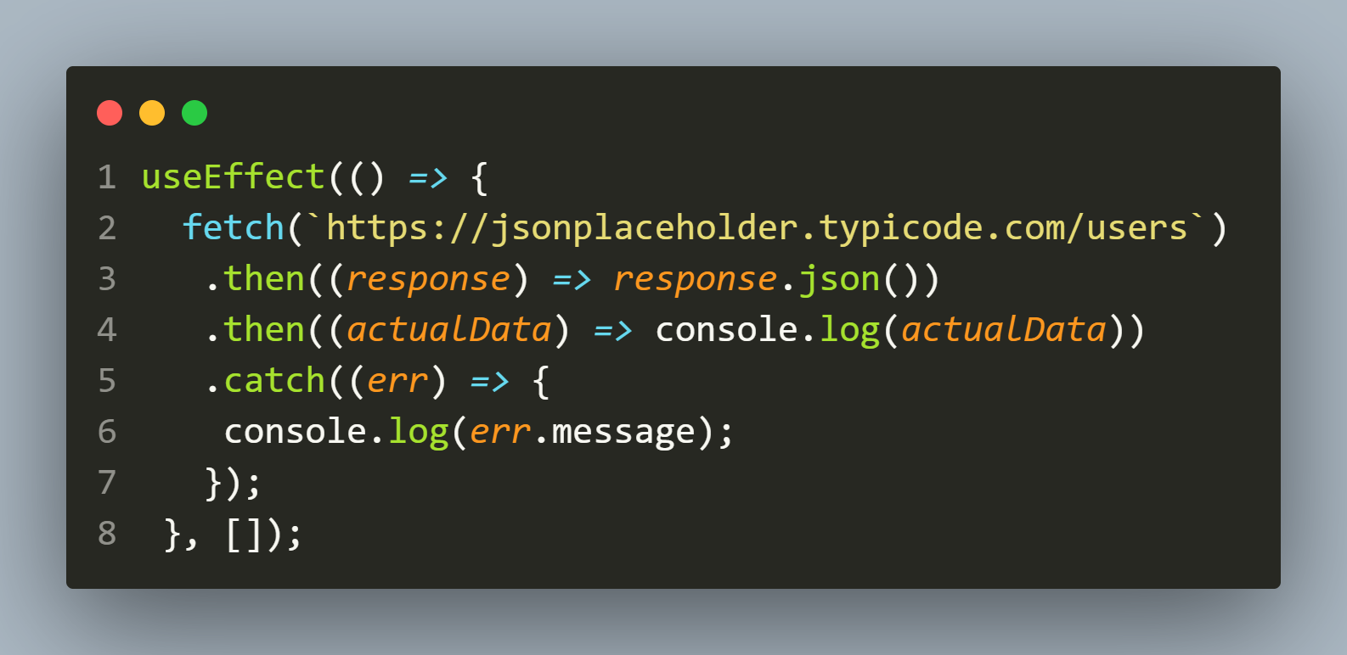
Using fetch()
In case the promise rejects, we will handle the error using the .catch() like so

Slide 35
Using fetch()
Note that the promise returned from the fetch() method only rejects on a network failure; it won’t reject if we hit a wrong or nonexisting endpoint like …/usersssss.
In this case, the method .catch() will not catch that error, so we must manually handle that.

Slide 36
Using fetch()
The Response object has a key called ok.
If we hit the correct endpoint the ok is true , else it returns false.

Slide 37
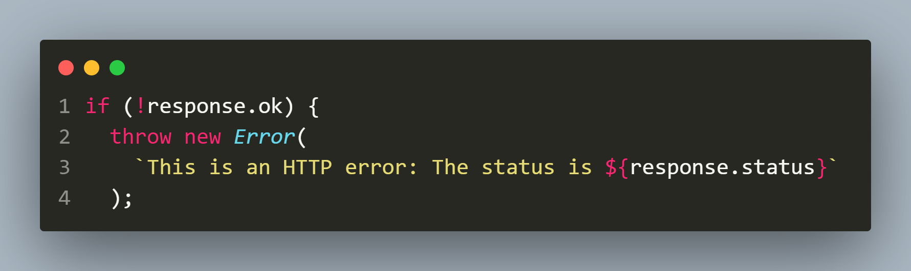
Using fetch()
By checking for that status, we can write a custom error message for a “404 Not Found” like so:

Slide 38
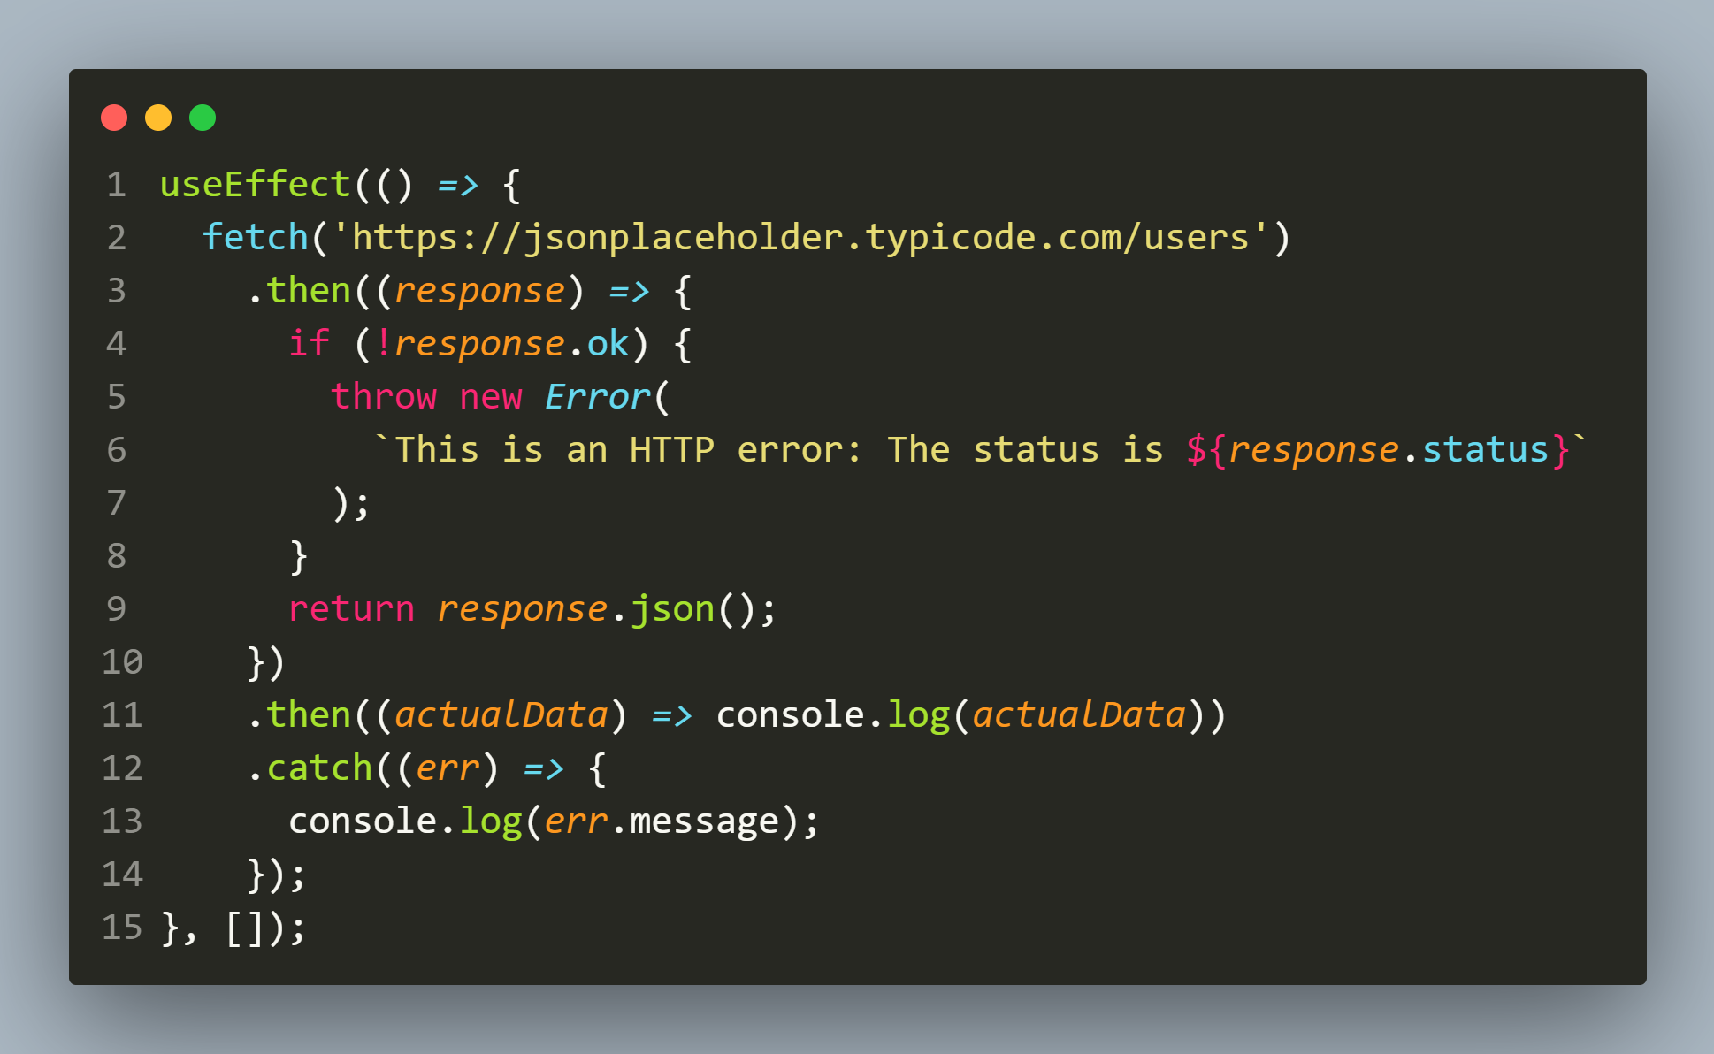
Using fetch()

Slide 39
Using fetch()
Presently, we have the users in the console.
Instead, we want to render them in our app.
To do that we must update the state and render the UI.

Slide 40
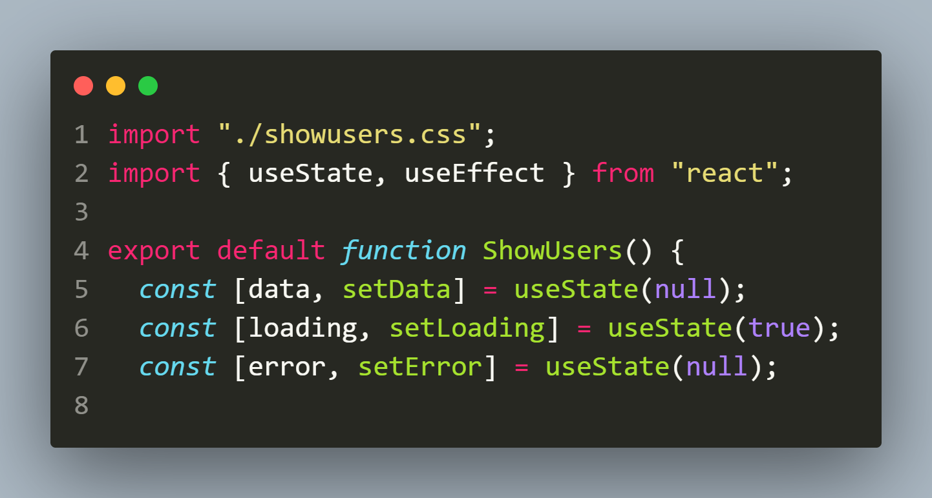
Using fetch()

Slide 41
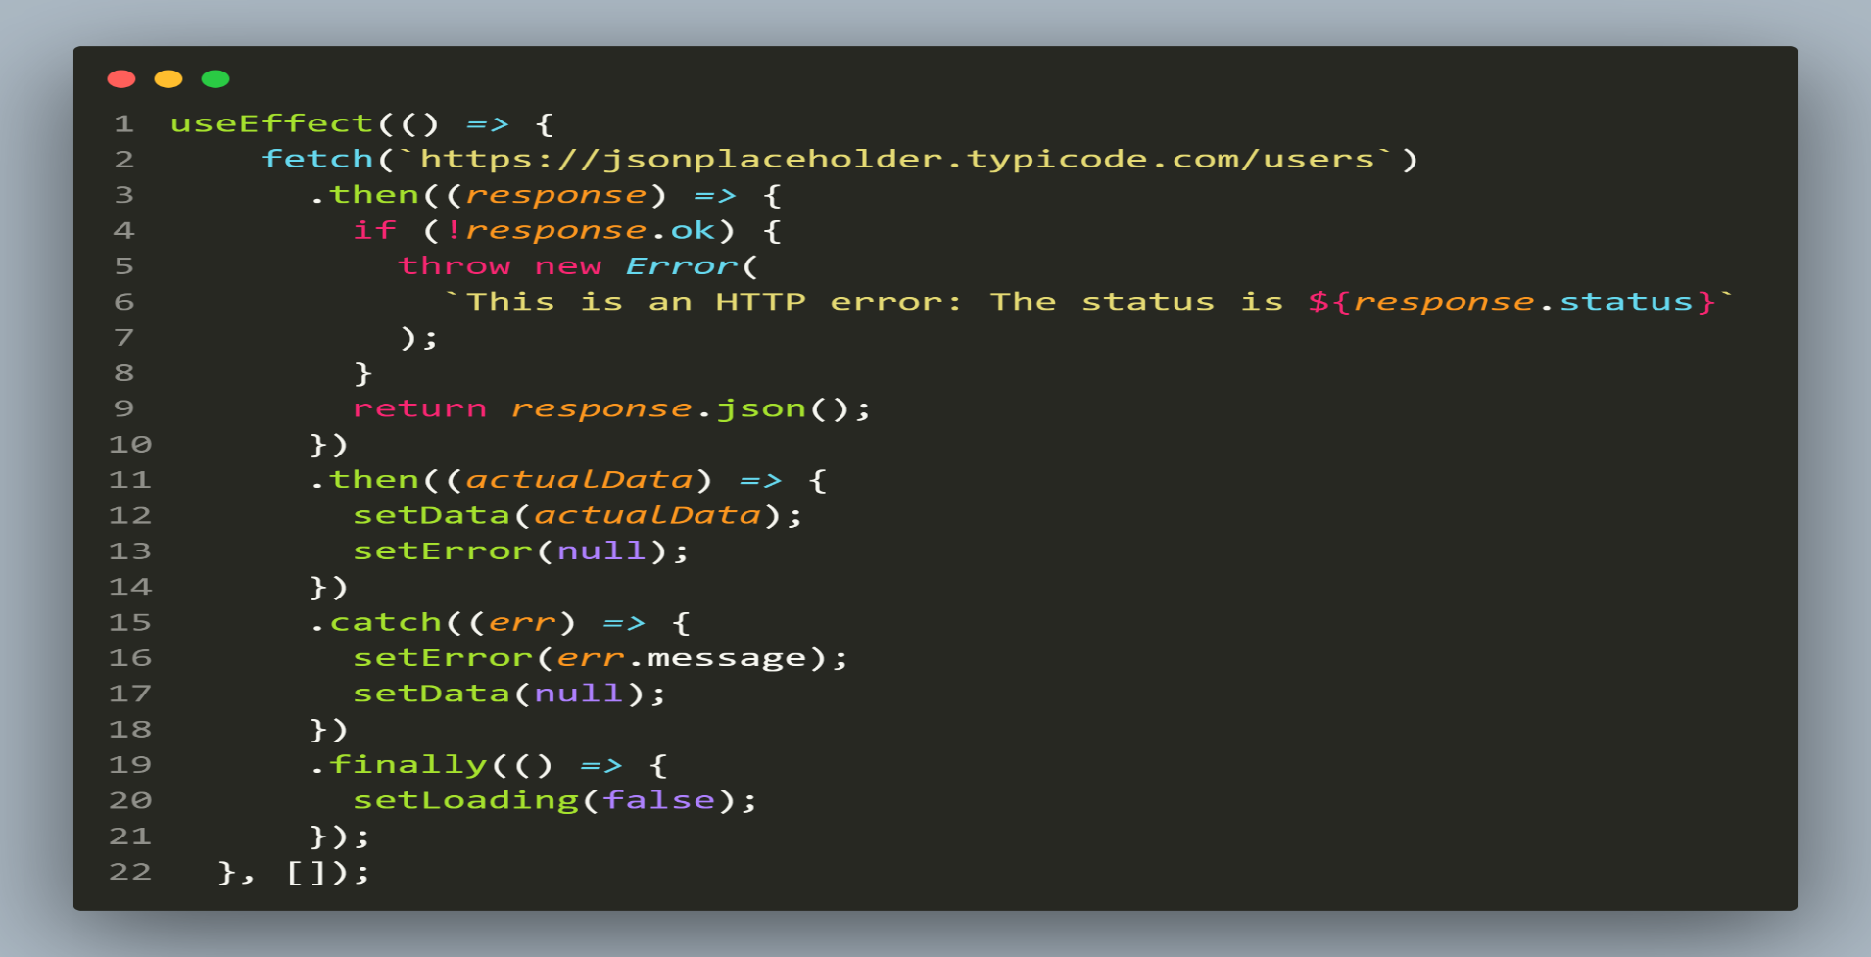
Using fetch()

Slide 42
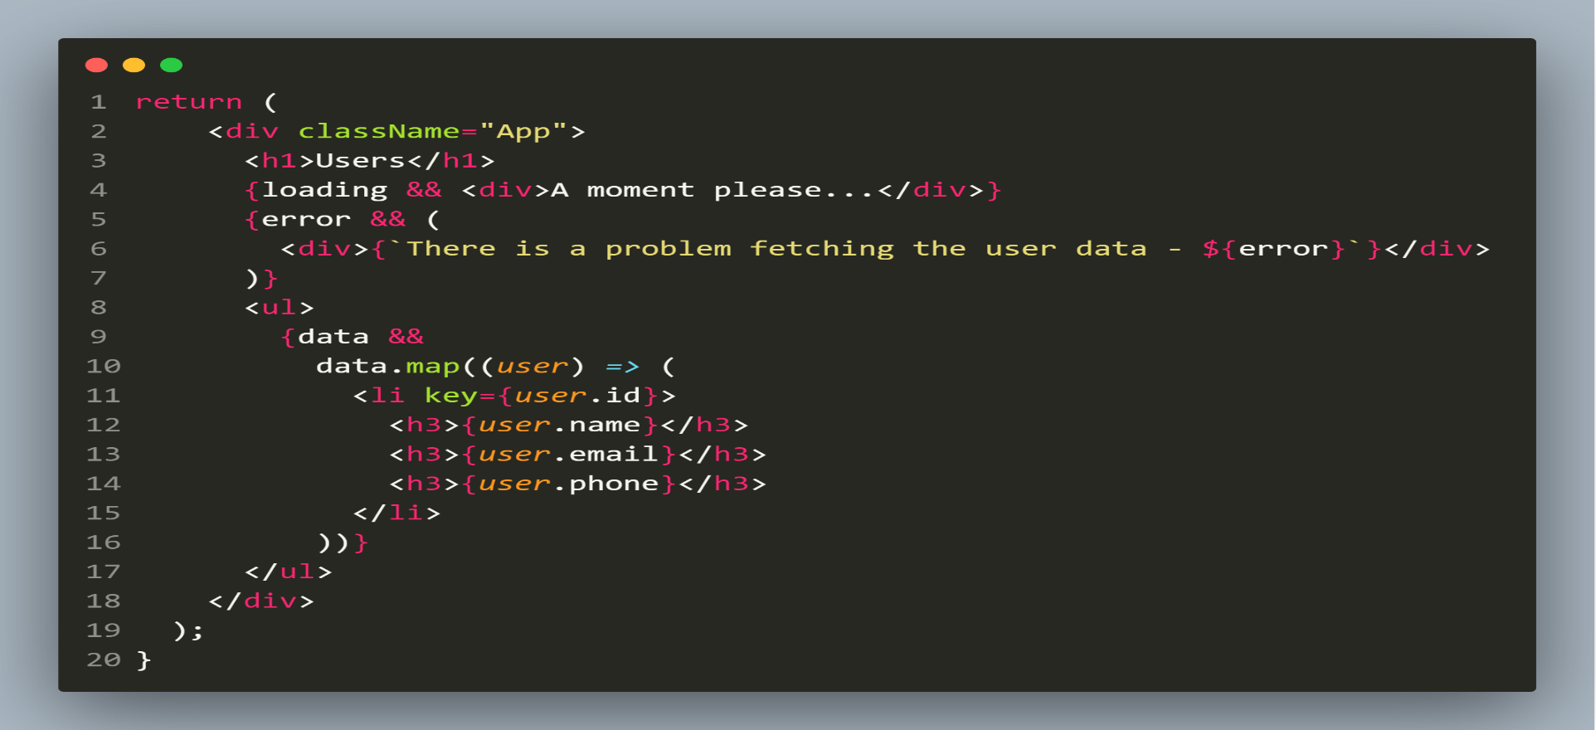
Using fetch()

Slide 43
Exercise
Write an HTTP based application to get the current date and time in INDIA from the server of worldtimeapi and display it on the page.
The URL to be requested is:
http://worldtimeapi.org/api/timezone/Asia/Kolkata

Slide 44
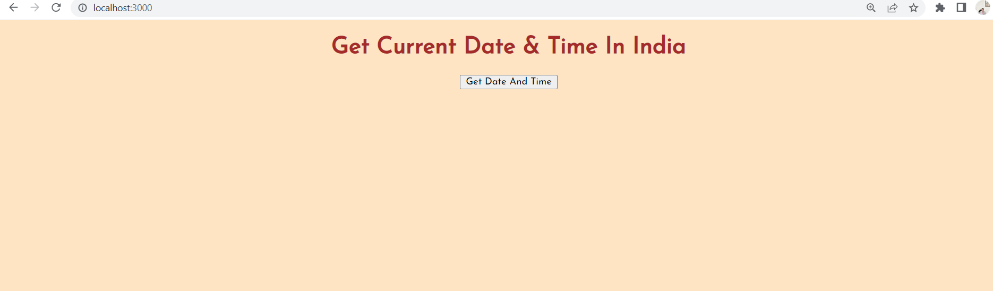
Desired Output

Slide 45
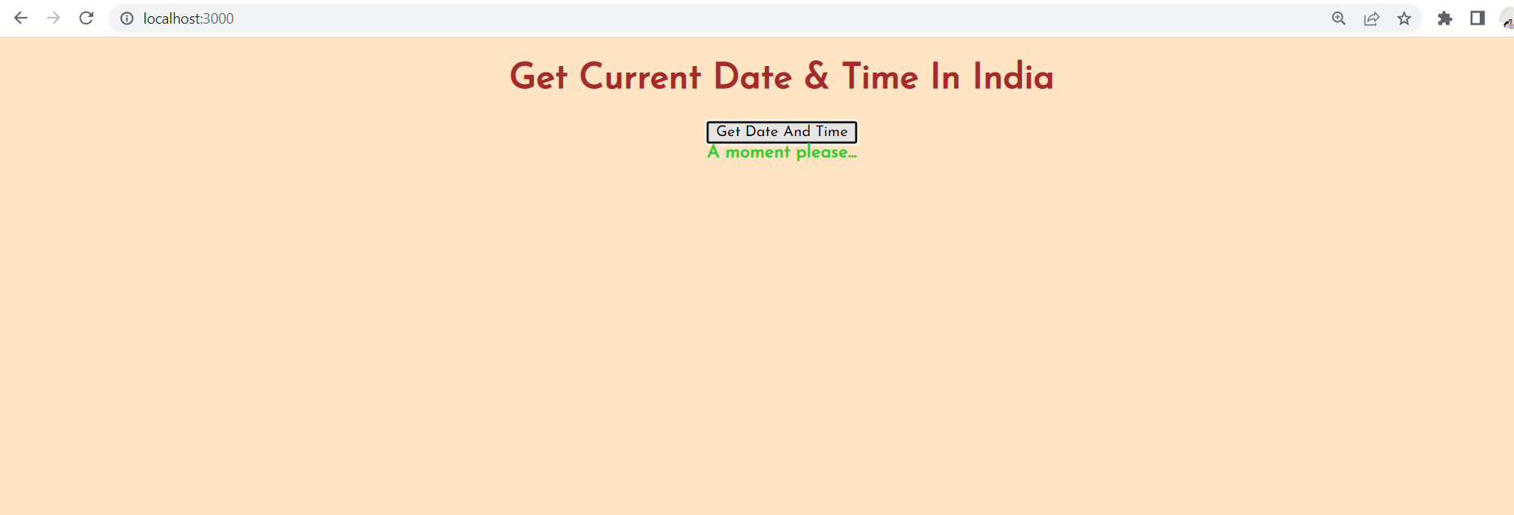
Desired Output

Slide 46
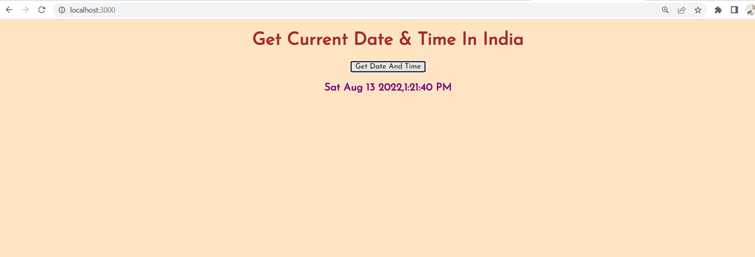
Desired Output

